Slide 1
Queue

Slide 2
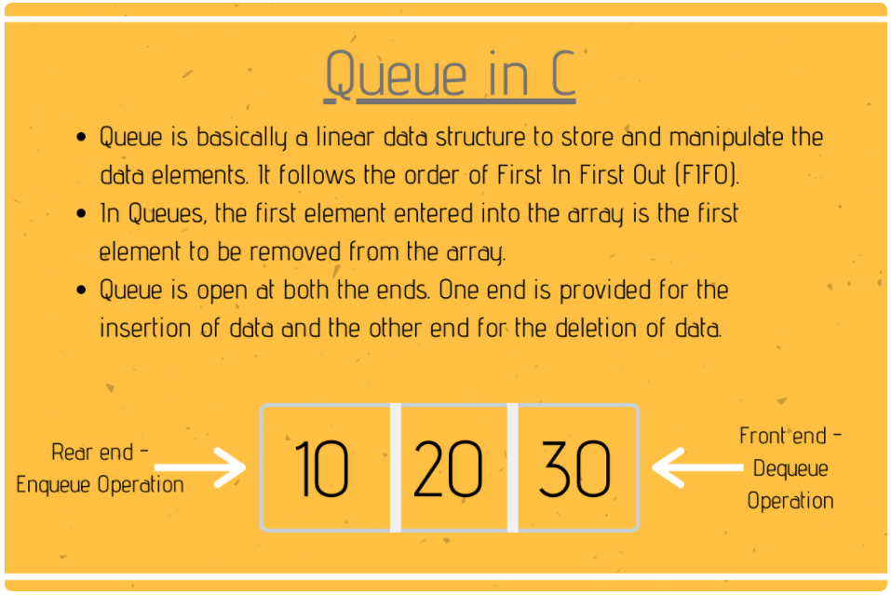

Slide 3
Contd…
1. rear is a pointer points to the latest element which was inserted
2. front is a pointer points to the last value which was inserted.
STACK is LIFO or FILO
Queue is FIFO or LILO

Slide 4
Working of Queue Data Structure
Queue follows the First-In-First-Out pattern. The first element is the first to be pulled out from the list of elements.
Front and Rear pointers keep the record of the first and last element in the queue.
At first, we need to initialize the queue by setting Front = -1 and Rear = -1
In order to insert the element (enqueue), we need to check whether the queue is already full i.e. check the condition for Overflow. If the queue is not full, we’ll have to increment the value of the Rear index by 1 and place the element at the position of the Rear pointer variable. When we get to insert the first element in the queue, we need to set the value of Front to 0.
In order to remove the element (dequeue) from the queue, we need to check whether the queue is already empty i.e. check the condition for Underflow. If the queue is not empty, we’ll have to remove and return the element at the position of the Front pointer, and then increment the Front index value by 1. When we get to remove the last element from the queue, we will have to set the values of the Front and Rear index to -1.

Slide 5
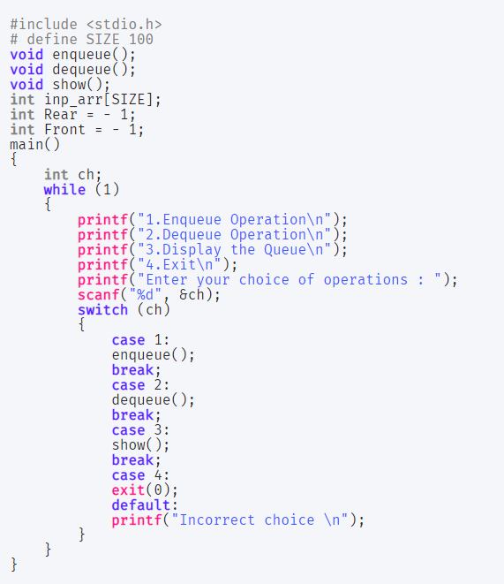

Slide 6
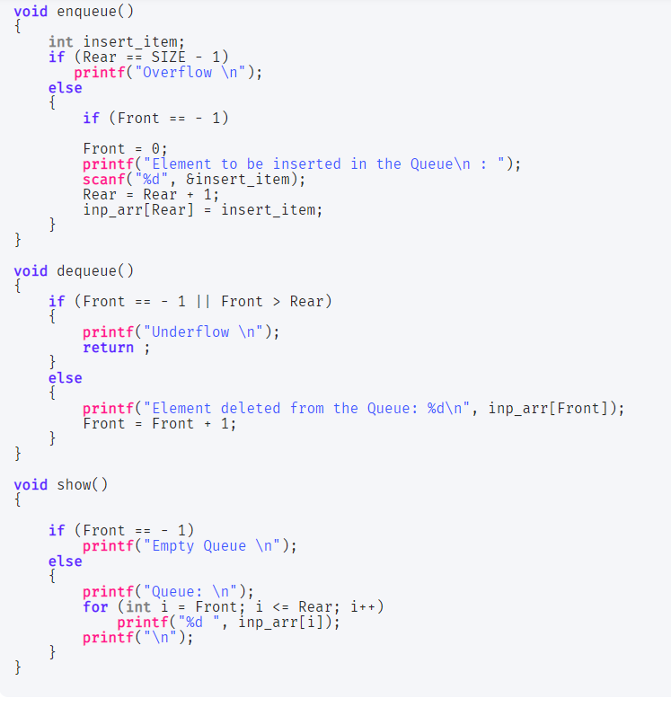

Slide 7
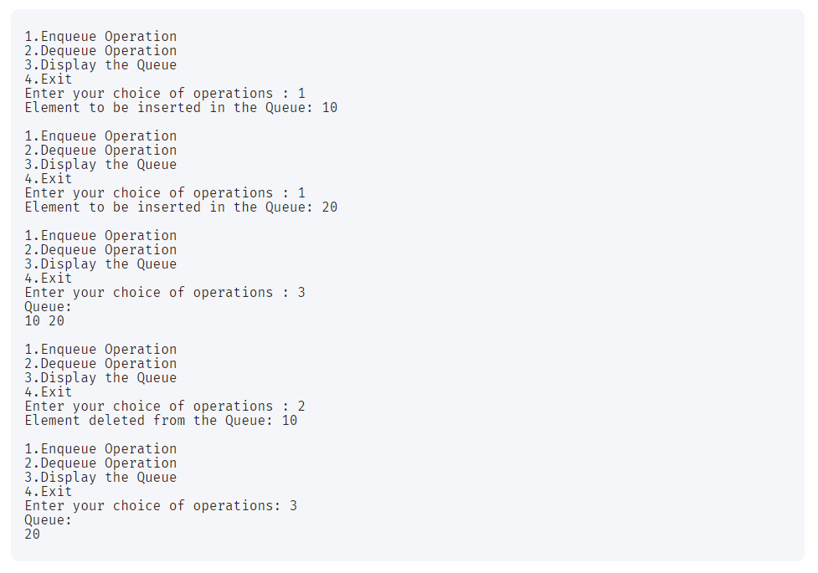
Output

Slide 8
Circular Queue
int Enqueue()
{
rear = (rear+1) mod n;
if(front == rear)
{
printf( “Q is full”)
If (rear ==0)
rear = n-1;
else
rear = rear-1;
return;
}
else
{
q[rear] = item;
return;
}
}
int Dequeue()
{
if(front == rear)
{
printf( “Q is empty”);
return -1;
}
else
{
front = (front+1) mod n
Item = q[front];
return item;
}
}
2
1
r
3
0
f
r

Slide 9
2
2
1
1
2
r
r
1
10
20
10
20
10
30
3
0
3
0
3
0
r
f
f
f
Enqueue( 10)
Enqueue( 20)
Enqueue( 30)
2
f
2
1
2
1
1
f
f
20
10
20
30
30
30
40
3
0
3
0
3
0
r
r
r
10 <-Dequeue( )
20 <-Dequeue( )
Enqueue(40 )

Slide 10
2
1
f
r
50
Now Enqueue(60 ) would print “Q is full”
and (rear = rear-1) gets executed.
30
40
3
0
Enqueue(50 )

Slide 11
Queue Implementation using Linked List

Slide 12
Basic Idea
Basic idea:
Create a linked list to which items would be added to one end and deleted from the other end.
Two pointers will be maintained:
One pointing to the beginning of the list (point from where elements will be deleted).
Another pointing to the end of the list (point where new elements will be inserted).
Rear
Front
DELETION
INSERTION

Slide 13
QUEUE: LINKED LIST STRUCTURE
ENQUEUE
front
rear

Slide 14
QUEUE: LINKED LIST STRUCTURE
DEQUEUE
front
rear

Slide 15
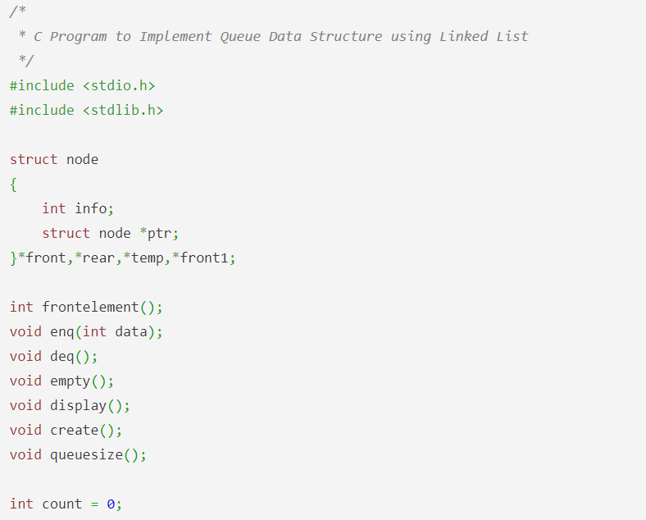

Slide 16
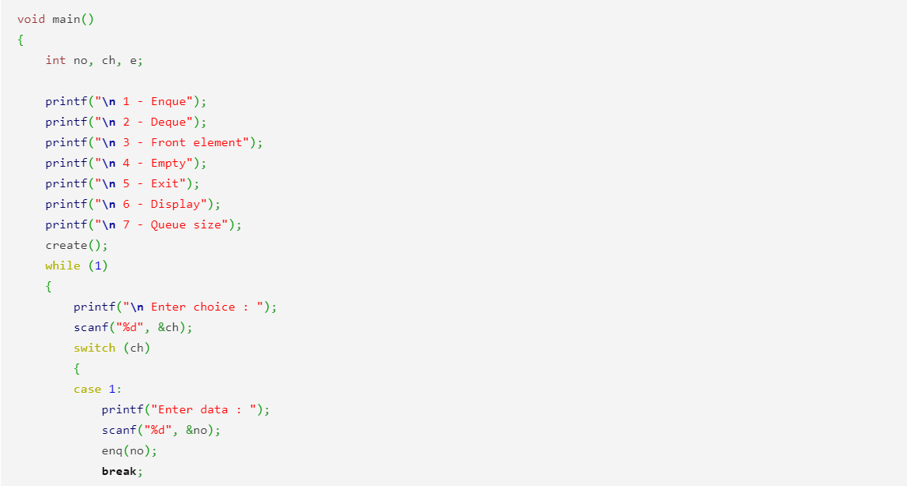
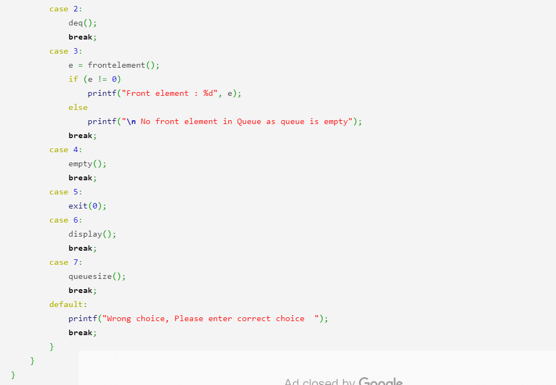

Slide 17
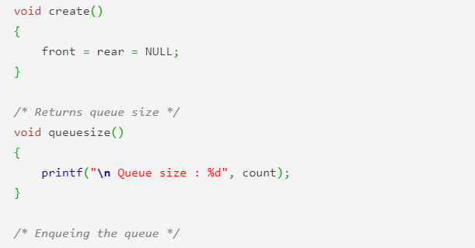
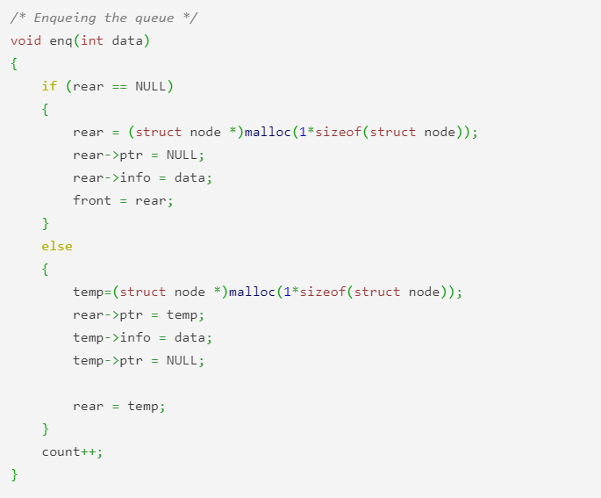

Slide 18
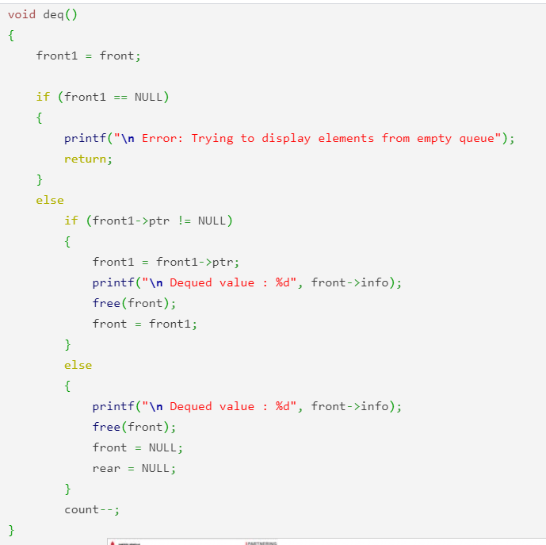
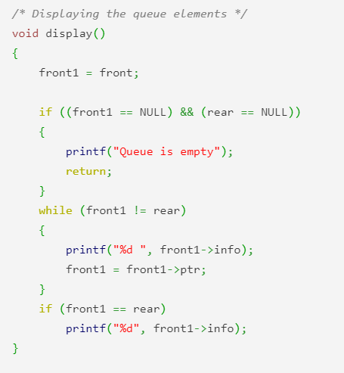

Slide 19
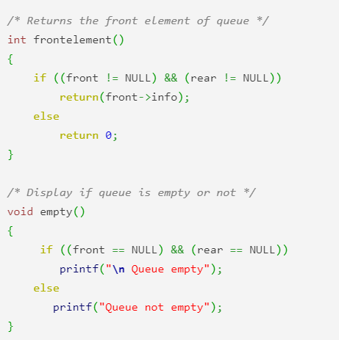

Slide 20
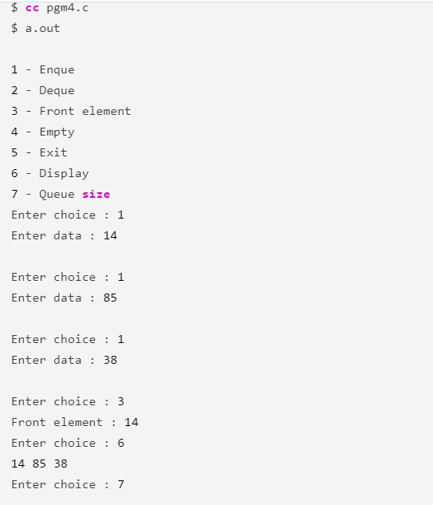
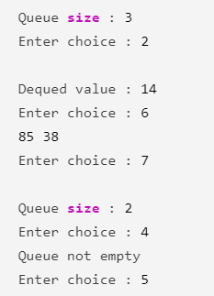

Slide 21
Note: We need one pointer to implement stack
Note: We need two pointers to implement Queue

Slide 22
Applications of Queue
Queue, as the name suggests is used whenever we need to manage any group of objects in an order in which the first one coming in, also gets out first while the others wait for their turn, like in the following scenarios:
Serving requests on a single shared resource, like a printer, CPU task scheduling etc.
In real life scenario, Call Center phone systems uses Queues to hold people calling them in an order, until a service representative is free.
Handling of interrupts in real-time systems. The interrupts are handled in the same order as they arrive i.e First come first served.

